Slide 1
MAJOR PROJECT
ELECTRONIC SPARK IGNITION SYSTEM
ANKUR VERMA(0948231007)
GAURAV ARYA(0948231013)
GAURAV SAINI(0948231014)
SHUBHANGI SHARMA(0948231049)
VINITA DEVI(1048231903)

Slide 2
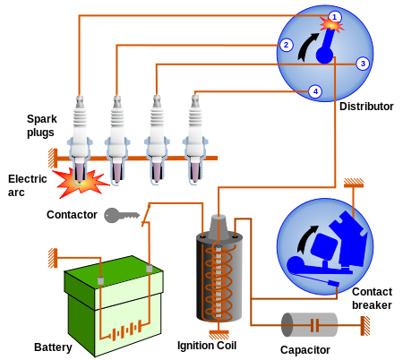
OVERVIEW IGNITION SYSTEM
The battery operated ignition system is most popular method for burning the fuel in four stroke internal combustion engine. In this system the CRANK SHAFT of the engine remains connected with DISTRIBUATOR mechanically. When driver starts the car actually it closes the switch and current starts flowing from battery to magnetic coil. The coil enhance the energy of battery up to 50,000v and supply it to the distributor which distributes it to the SPARK PLUGS connected to the pistons.

Slide 3
ELECTRONIC SPARK IGNITION SYSTEM
. A Hall effect sensor is a transducer that varies its output voltage in response to a magnetic field. It will provide the exact position of the piston inside the engine from which system will know about completion of 2nd stroke.
The main motive of this project is to replace the distributor by an electronic circuit in order to improve the fuel burning efficiency of the engine. The electronic spark ignition system will contain basically three sub- systems:-
Sensor
Microcontroller
Relay

Slide 4
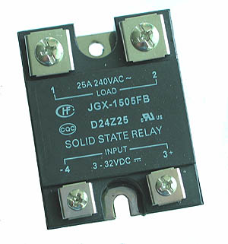
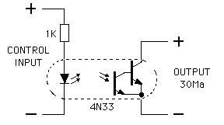
Relay:- Solid State Relay will switch the power of battery to the magnetic coil which will be transmitted to the spark plug.

Slide 5
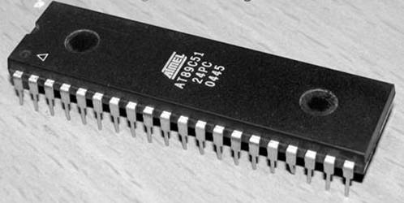
Microcontroller:- The microcontroller 8051(IC- AT 89C51) will be used. It will provide logic 1 to the relay depending on the square wave sent by sensor.

Slide 6
Progress with Deadline
DEADLINE
STEPS IMPLEMENTED PROGRESS %
^{25TH} March 2013
^{10th} April 2013
24th April 2013
Circuit Designing
Purchasing components 40 %
PCB Designing
Implementation on Hardware 50 %
Programming
Testing of circuit 100 %

Slide 7
Industrial Application
Four stroke internal combustion engine.
Two stroke diesel engines.
Rocket Engine

Slide 8
Members and Responsibility
Responsibility
Members
Circuit Designing
Purchasing components
PCB Designing
Implementation on Hardware
Programming
Testing of circuit
ANKUR VERMA
ANKUR VERMA, GAURAV ARYA, GAURAV SAINI
GAURAV ARYA, GAURAV SAINI
SHUBHANGI SHARMA, VINITA DEVI
ANKUR VERMA, GAURAV ARYA, GAURAV SAINI
ANKUR VERMA, GAURAV ARYA, GAURAV SAINI, SHUBHANGI SHARMA, VINITA DEVI

Slide 9
REFRENCE
Online Sources
[1]Wikipedia the free encyclopedia
[2] www.freescale.com
[3] www.omega.com
Books
[1] J Lars Eriksson, “Increasing the Eciency of SI-Engines by Spark-Advance Control and Water ” in Spark Advance Modeling and Control, Sweden: Linus & Linnea AB, 1999 ch. 4, pp. 71–80.
[2] M. A. Mazidi, J.G. Mazidi “8051 Microcontroller and Embedded System” Taiwan: HANEL
Patents
[1] J. David W. Vos, Boston, MA(US),Banjamin Russ, Catlett,VACU(US) “Optimazation Method For Power Zeneration System,” U.S. Patent 7,011,498 B2 March 14, 2006.
[2] Steven R.McCoy, Washington, IL(US), Sean O. Cornel, Gridly, IL(US), Robert M. Locas, Spring Valley, IL(US) ”Ignition System,” US Patent 8,091,352 B2 January 10, 2012.
Unpublished
[1] Kenny Lam “Digital Direct Current Ignition System Using HC08 Microcontrollers”
Published Papers
[1] Murtaza ACIKEL, Isa NAVRUZ, Filiz SARI “An Opto-Coupler and Spark Plug Combination
System for Vehicle Engine Ignition” International Journal of Engineering Research and Development, Vol.3, No.2, June 2011
[2] Pankaj Hatwar, Durgesh Verma,” Laser Ignition in Internal Combustion Engines ” International Journal of Modern Engineering Research (IJMER) Vol.2, Issue.2, Mar-Apr 2012 pp-341-345

Slide 10
THANKYOU

